Slide 1
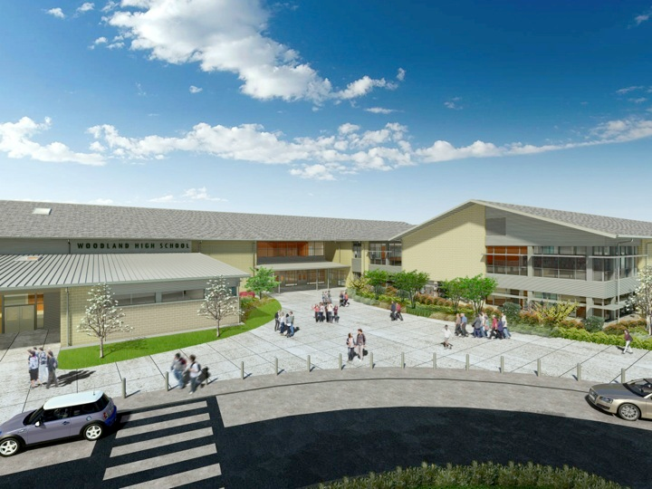
Woodland Public Schools
Facilities and Safety Report
October 2017

Slide 2
FACILITIES REPORT
USNR CNC USNR has graciously donated a fully operational CNC machine to the school district. The tool will be moved from USNR on the December 18th. It will reside in the SW corner of the auto shop at WHS and will be a great additional to our high school programs. I expect to have it fully facilitated by the end of January. This tool is big, measures 8 X 14 feet, 9 feet tall and weighs approximately 6 tons.
Emergency Operations planning I have completed a new District Emergency Operations Plan. I will send the draft Procedure and Policy revision to the Superintendent within two weeks. The new plan unifies planning and response procedures for the district and all schools. The procedure has two distinct sections, District level planning and school level planning. School level emergency plans are customized to each school based on the geographical location of that school. The plans (both district and school level) have detailed procedures for emergencies, reunification, pre-disaster modeling, incident command and other elements that are necessary for an all encompassing Emergency Response plan.
Solar Possibilities One of my goals when I first started here was to establish a renewable energy project at each school. Recently I have been working with Cowlitz PUD and have made inquires with Solar World of Oregon for the design of the system. The PUD offers some extremely good incentive opportunities for the purchase of an array and power buy back incentives that are essentially twice what we currently pay for power. The tentative plan has an 13kw array being installed at WHS expandable at 5kw per year by students. My goal is to kick this off in the spring….more to come!

Slide 3
Facilities Report Continued
Property at 2280 Lewis River Rd.
I have obtained the permits necessary from the SWCAA (Southwest Clean Air Agency) for the Demo. I expect to have the house demolished during the Christmas break period. All utilities and services have been disconnected and all required environmental inspection are complete.
Music room WPS
Completed the installation of a drop ceiling and LED retrofit at WPS music room. The room (converted last summer from a locker room) had an unacceptable level of reflected noise due to the original construction of the space. To correct this issue an acoustical ceiling was added with new LED fixtures that will be able to fall into the PUD rebate program. The Art room will retrofitted with the same ceiling as the Music room with work starting on the week of November 20th

Slide 4
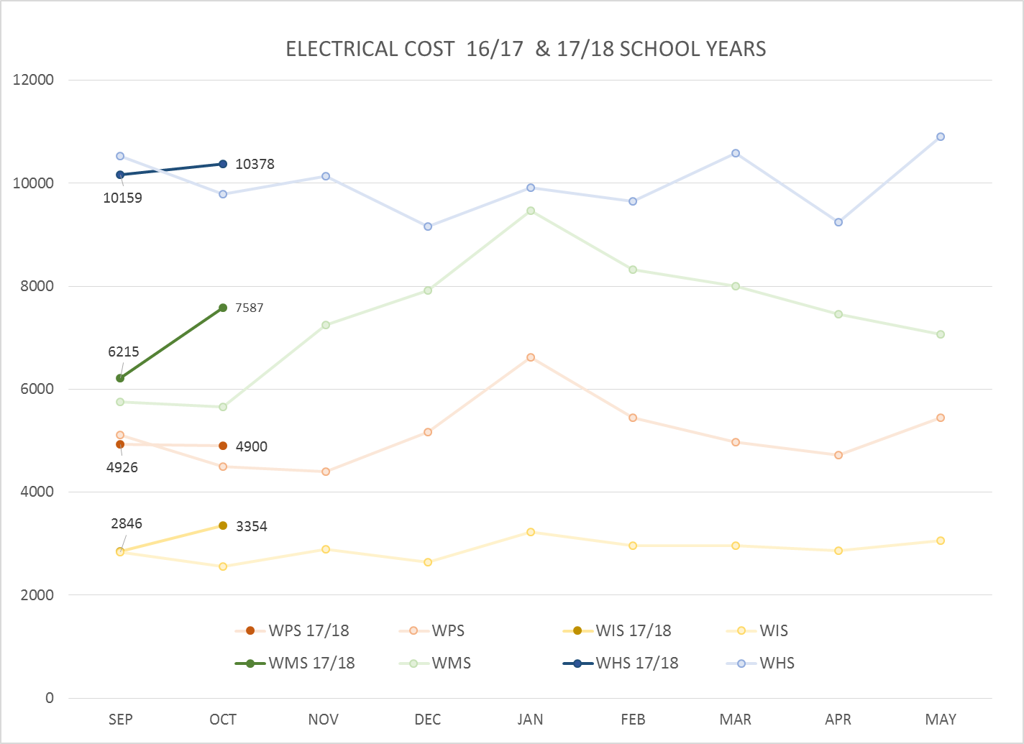
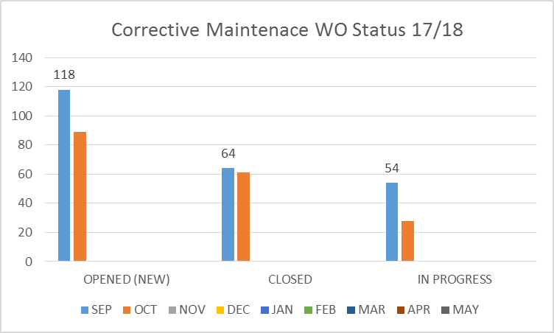
FACILITY CHARTS – POWER COST AND WORK ORDER STATUS
All power bills up slightly due to 31 day billing cycle in Oct. verses 28 days in September.
WIS show slight increase above baseline due to new portable buildings.
We are investigating the large power spike at WMS. This is not typical consumption for this time of the year.

Slide 5
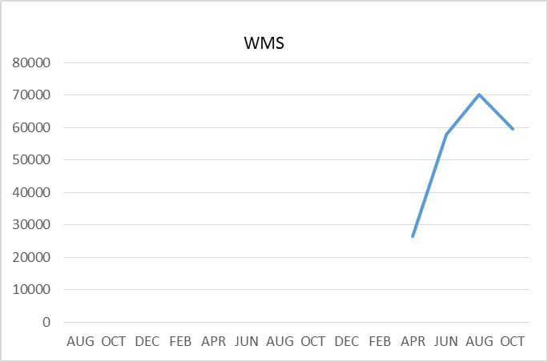
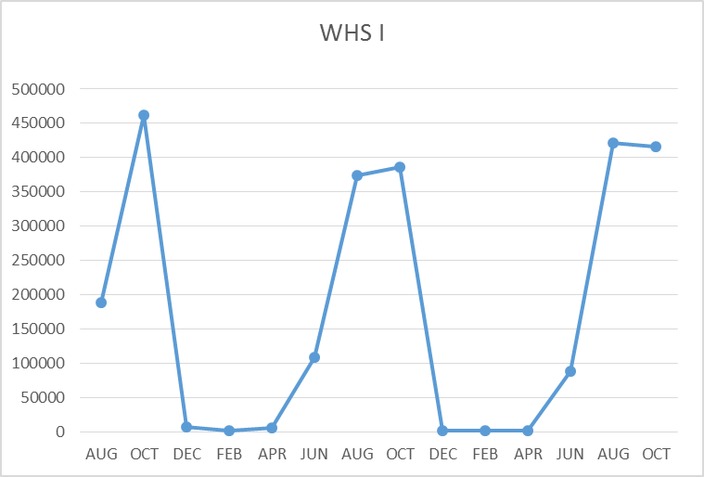
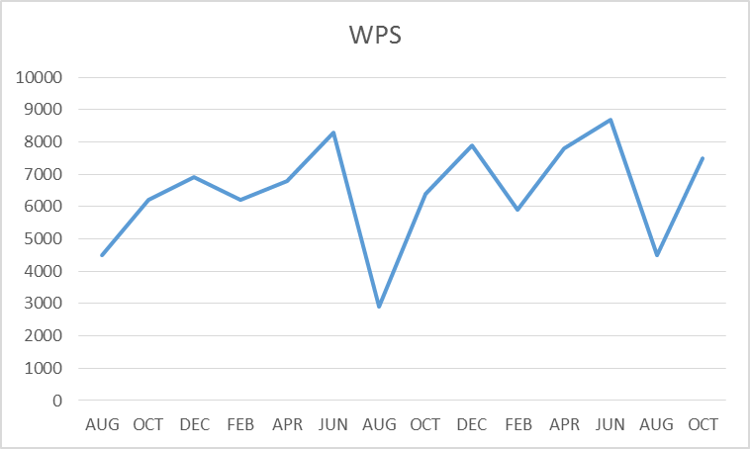
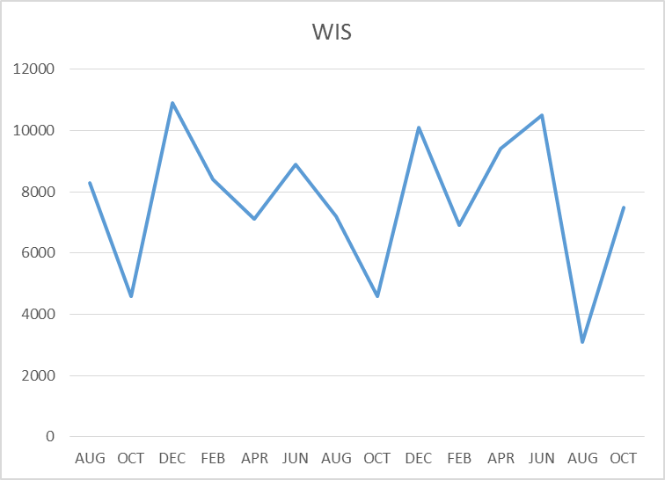
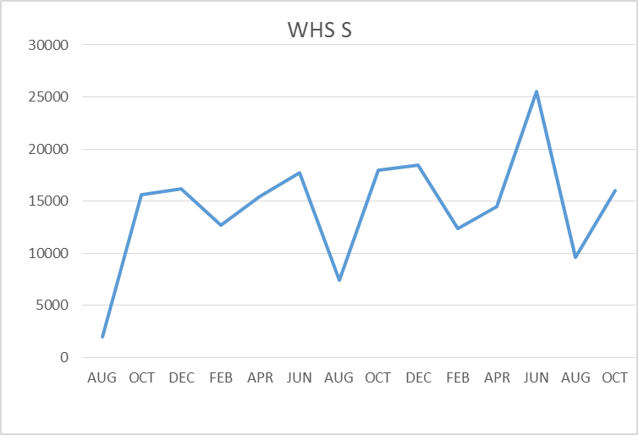
FACILITY CHARTS –
WATER USAGE
WHS, WIS, WMS, WPS
Water charts are updated every two
Months, next update to these charts
in January 2018
The WMS chart has been reconfigured to include the following 7 meters: 755 park high and low flow, BO and Team High, Pit house, buss barn, athletic field and DO. All of these meters are totaled on the WMS graph but each data point is recorded separately to aid in identifying leaks.

Slide 6
SAFETY Report
Accidents for the month
There were a total of 8 student injuries, 14 staff incidents and accidents
Staff Accidents/Incidents
WPS - Student behavior caused injury to IA (9 events)
Yale – Two employees slipped on wet floor (2 events)
WMS – Teacher dropped tool on foot, fractured foot
WMS – Para slipped on wet floor
WMS employee got finger pinched in office equipment
Student Accidents/Injuries (8)
WPS - Student slipped on stair bruised knee and forehead
WPS - Student tripped on shoe of another student, fractured fibula
WIS – Student tripped on another student and bruised arm
WIS – Students head hit ground being spun by another student, treated for possible concussion
WHS – Student cut finger with scissors in class, finger glued, no stiches
WHS – Sanding metal, the sander grabbed the work, hand contacted sander, 2 stiches
WHS – Football head injury, possible concussion, staff followed concussion protocol (2 events)

Slide 7
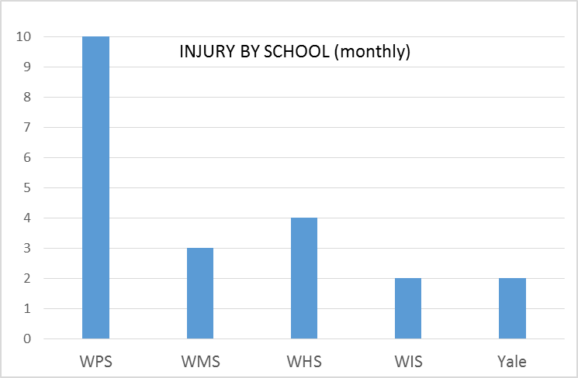
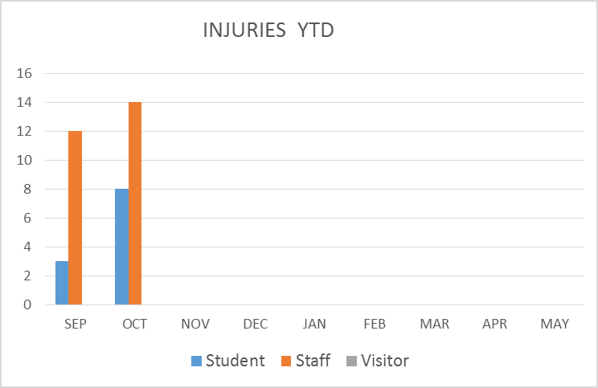
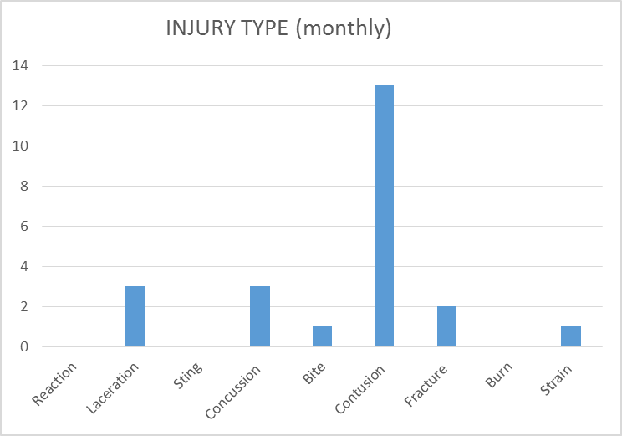
SAFETY CHARTS

